Slide 1
DR & BDR LABORATORY
JAHINA AL KHANJARI
22.05.2025

Slide 2
LABORATORY REQUIREMENTS
Design a network with OSPF routing protocol that has three areas, area 0,
area 1 and area 2. Area 0 and area 2 are connected to area 1. However,
area 0 and area 2 are not directly connected.
Configure priority to determine the designated router (DR).
Stop OSPF Hello Packets sent to hosts.
Configure OSPF authentication type 2 between R3 and R5. In addition,
configure authentication type 1 between R5 and R6.

Slide 3
LABORATORY CHALLANGE
In OSPF, all areas should be connected to area 0 directly or via a special solution.
In this lab I am going to implement a solution by creating a virtual link in the two
Area border routers. This makes area 2 virtually connected to area 0.

Slide 4
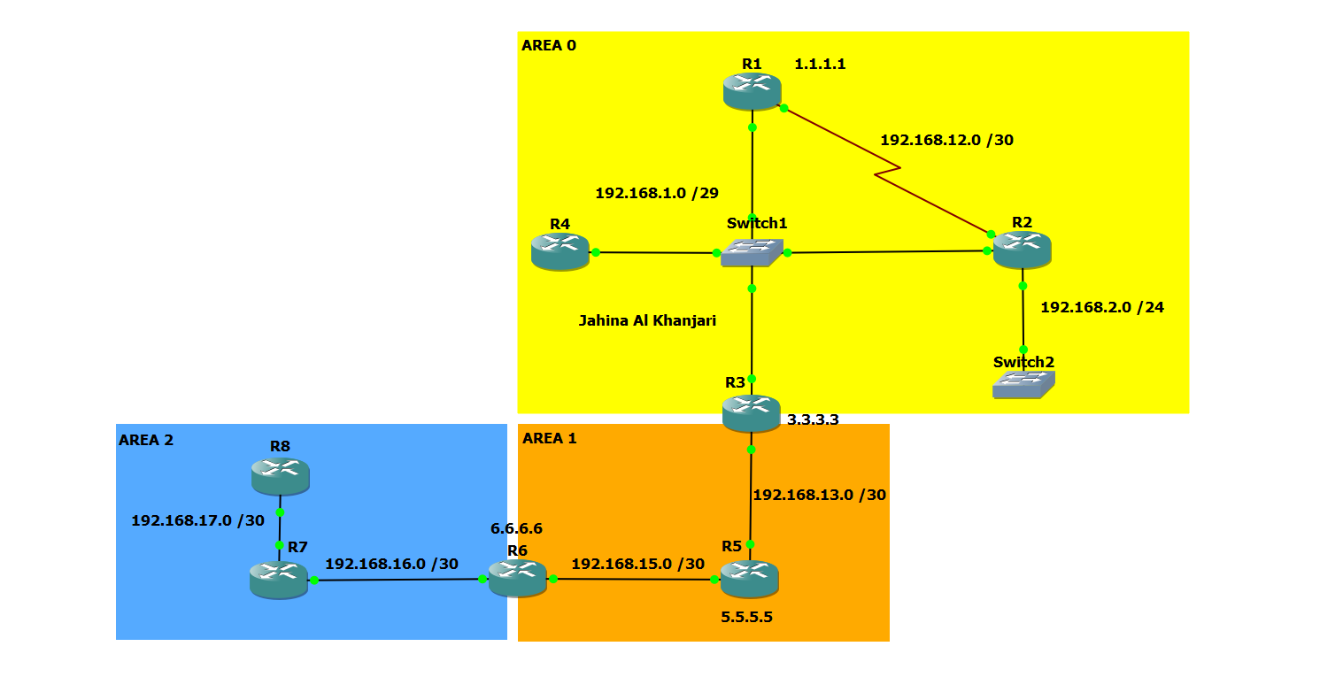
NETWORK DIAGRAM

Slide 5
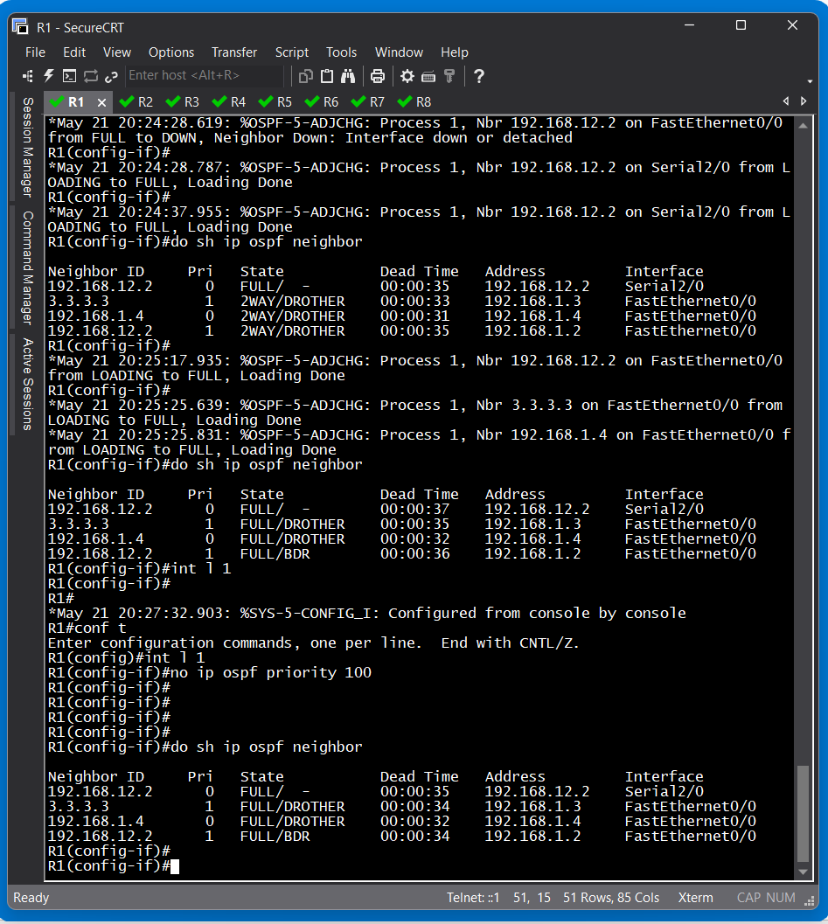
R4 PRIOEITY SET TO ZERO

Slide 6
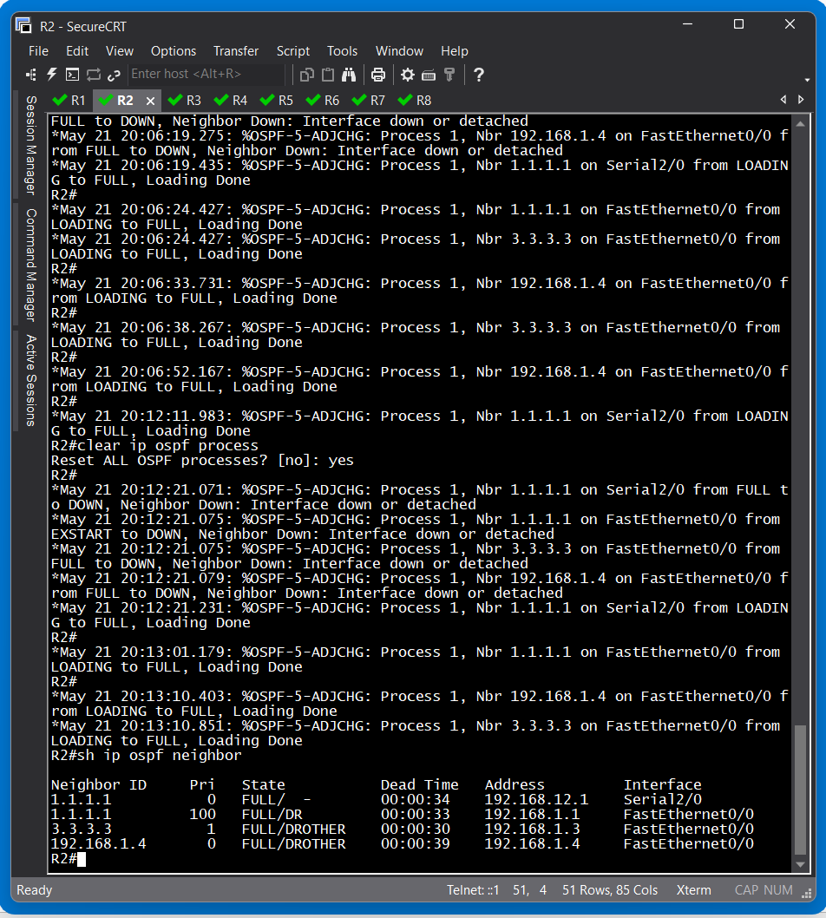
R1 PRIOEITY SET TO 100

Slide 7
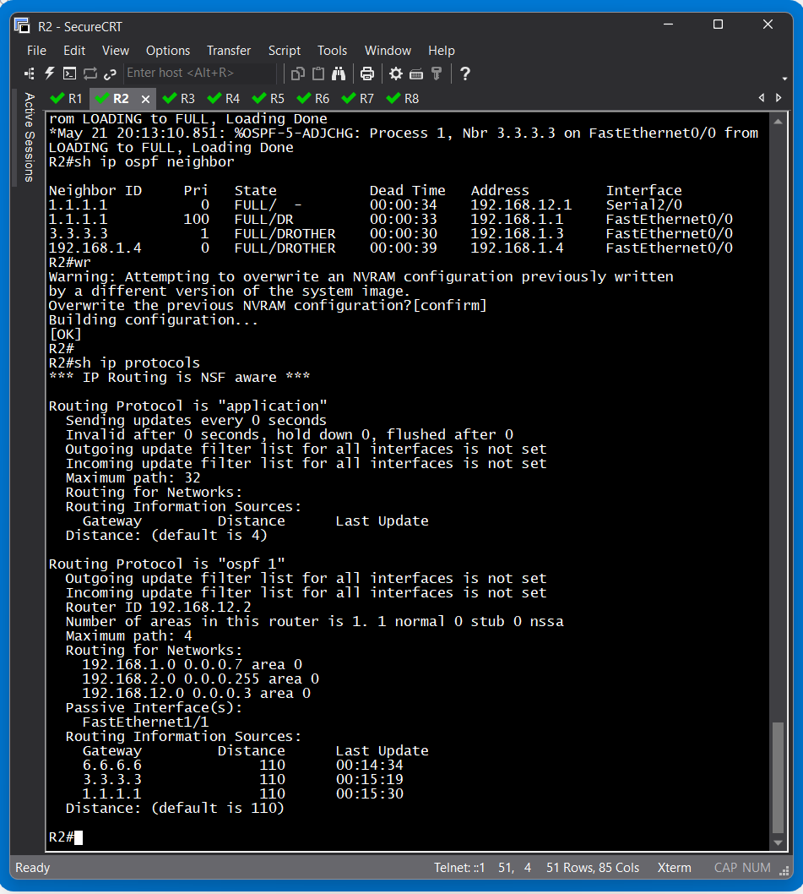
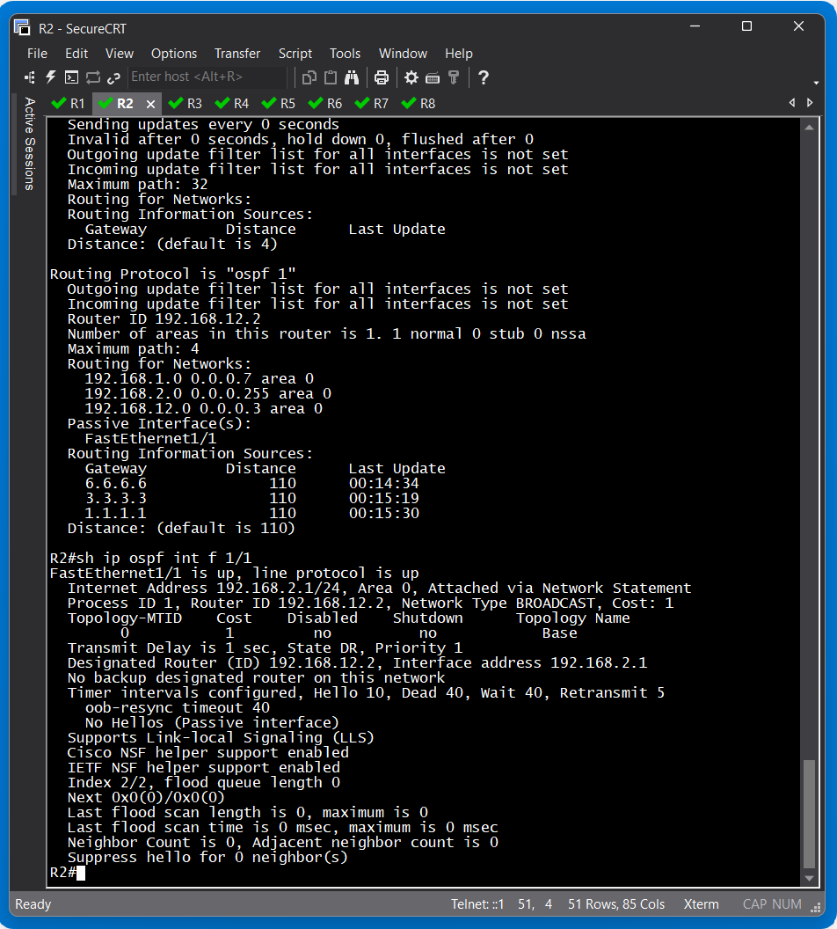
PASSIVE INTERFACE
FOR F 1/1 IN R2

Slide 8
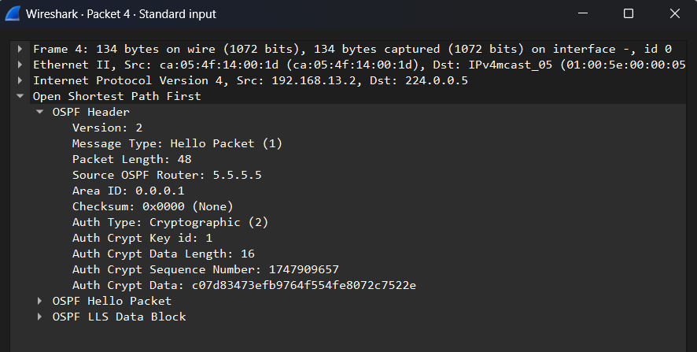
AUTHINTICATION TYPE 2
BETWEEN R3 & R5

Slide 9
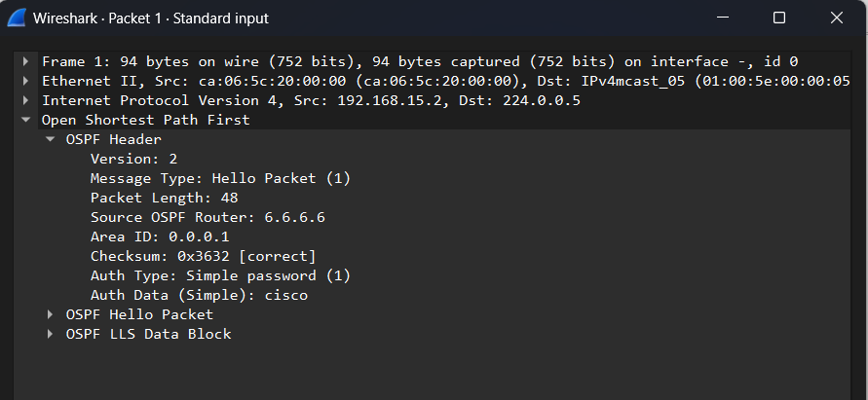
AUTHINTICATION TYPE 1
BETWEEN R5 & R6

Slide 10
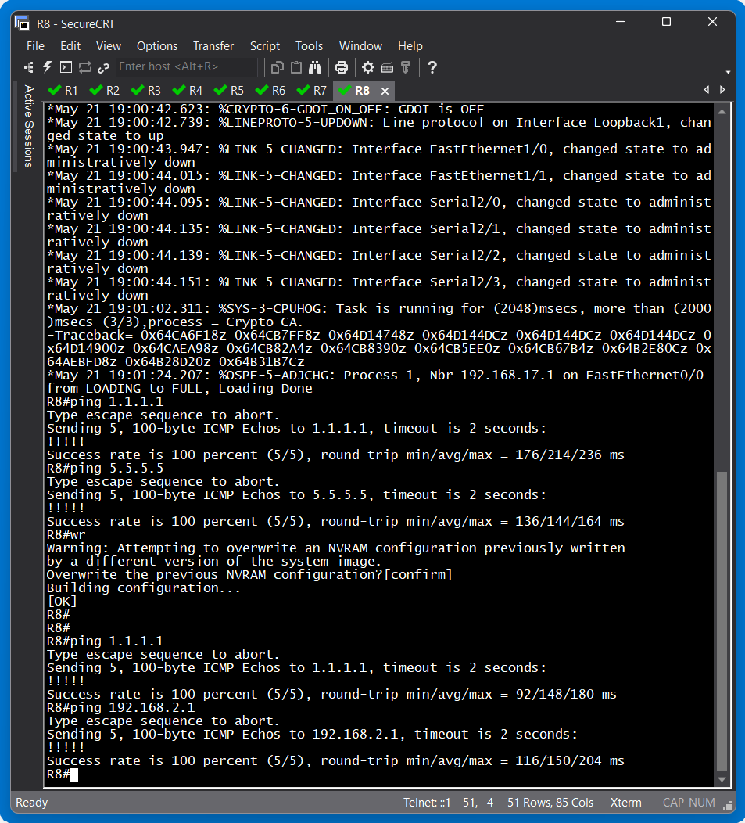
CONNECTIVITY TEST
R8 which is in area 2 is able to
Communicate with R1 which is
In area 0 and vice versa.

Slide 11
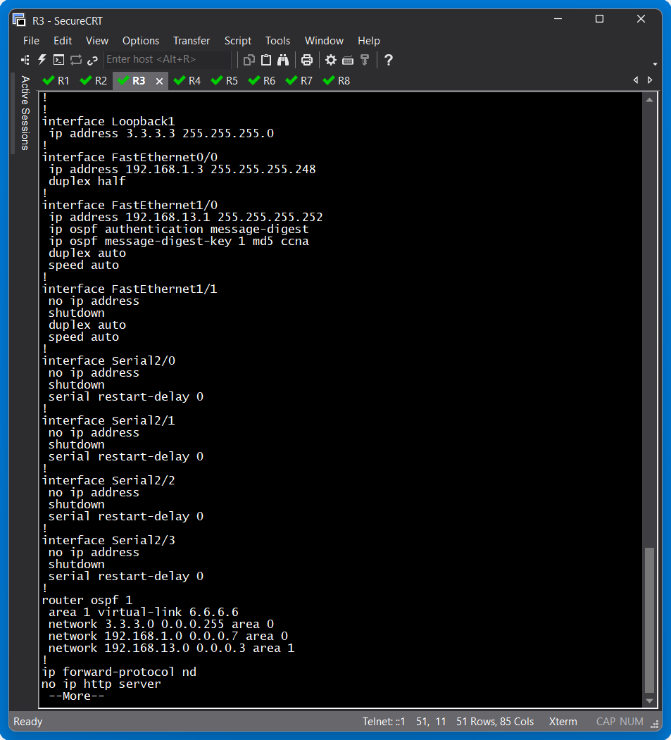
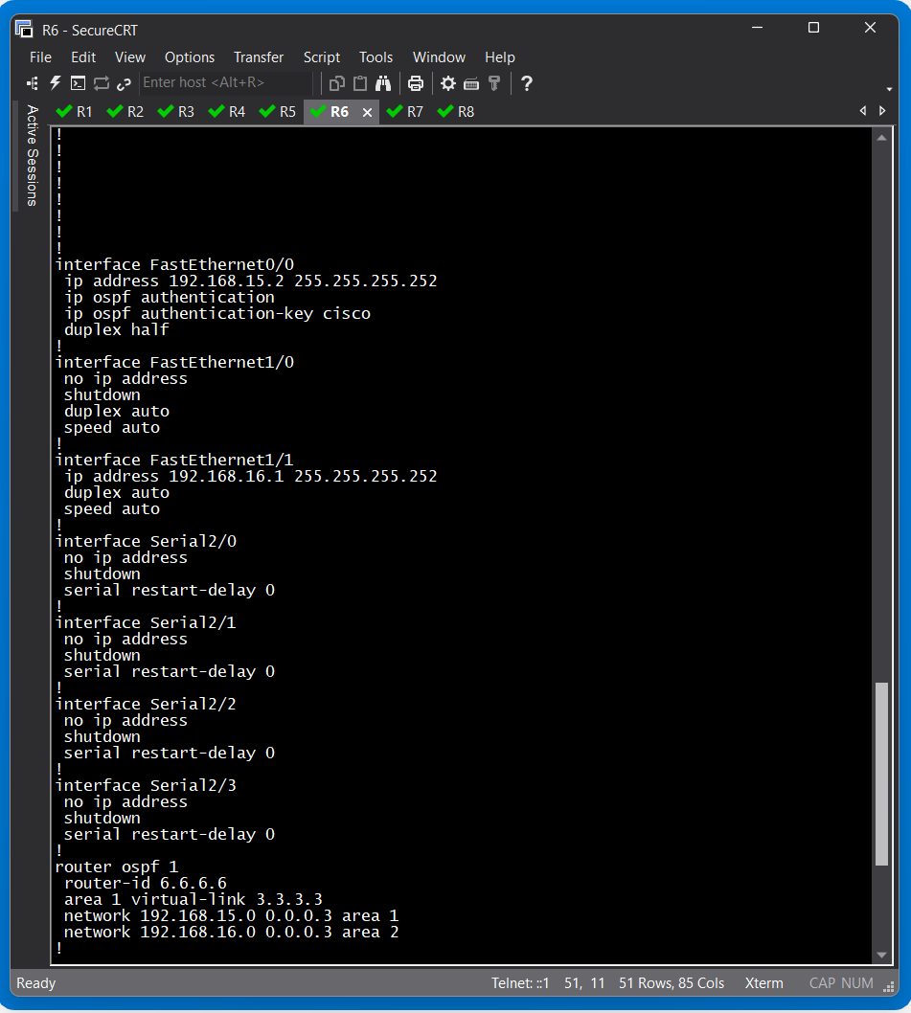
VIRTUAL LINK CONFIGURATION

Slide 12
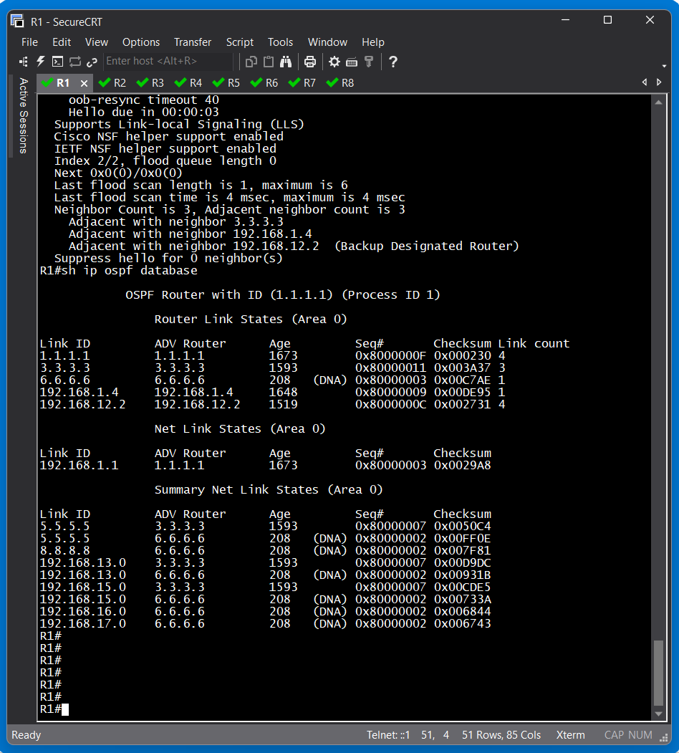
R1 OSPF DATABASE

Slide 13
THE END

